Slide 1
Deep Learning Summer School
Introduction to PyTorch Part 2
Lucas Dyssel

Slide 2
Regularization
MyNetwork is a standard neural network
Adding the L2 regularization term to the loss function should happen inside of the training loop:
L2_lambda is a hyperparameter which determines the strength of of L2
torch.norm(MyModel.fc1, p=2) calculates the L2 norm (Euclidian norm) of the weights of the first fully connected layer
p=1 is L1 regularization and p=2 is L2 regularization
loss += L2_lambda * torch.norm(MyModel.fc1, p=2) the combined regularization term is added to the loss, penalizing large weight
class MyNetwork(nn.Module): def __init__(self, input_size, output_size): super(NNetwork, self).__init__() self.fc1 = nn.Linear(input_size, 16) self.fc2 = nn.Linear(16, output_size) def forward(self, x): x = torch.relu(self.fc1(x)) x = torch.softmax(self.fc2(x)) return x net = MyNetwork(input_size=10, output_size=10) ######### INSIDE OF TRAINING LOOP ######### loss = criterion(outputs, targets) loss += L2_lambda * torch.norm(net.fc1.weight, p=2)

Slide 3
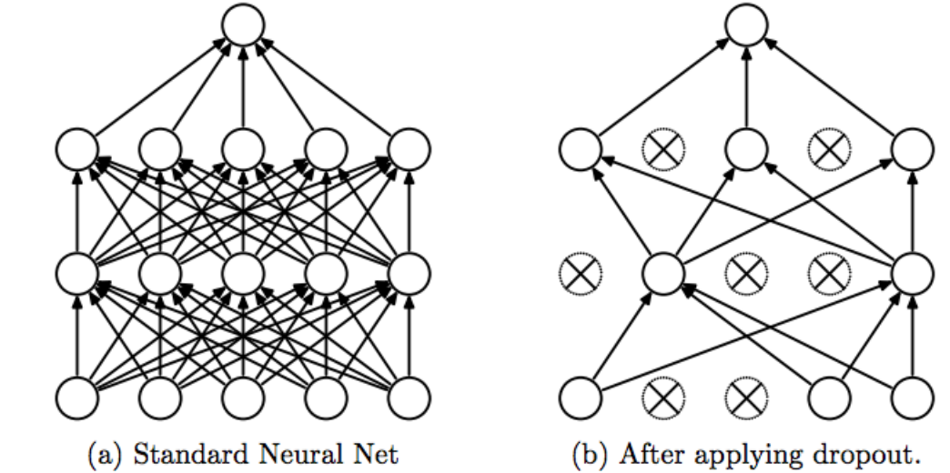
Dropout
p (float) – Probability of an element to be zeroed. Default: 0.5
inplace (bool) – If set to True, will do this operation in-place. Default: False
torch.nn.Dropout(p=0.5, inplace=False) # Example class NNetwork(nn.Module): def __init__(self): super(NNetwork, self).__init__() self.dropout = nn.Dropout(0.2) def forward(self, x): # Dropout is used inbetween two layers x = self.dropout(x)
Budhiraja, A. (2018, March 6). Learning Less to Learn Better — Dropout in (Deep) Machine learning. Medium. https://medium.com/@amarbudhiraja/https-medium-com-amarbudhiraja-learning-less-to-learn-better-dropout-in-deep-machine-learning-74334da4bfc5

